Slide 1
invisialign

Slide 2
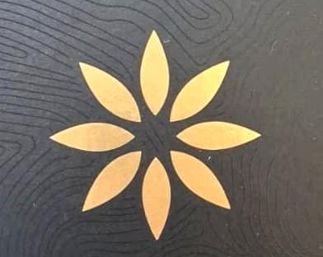
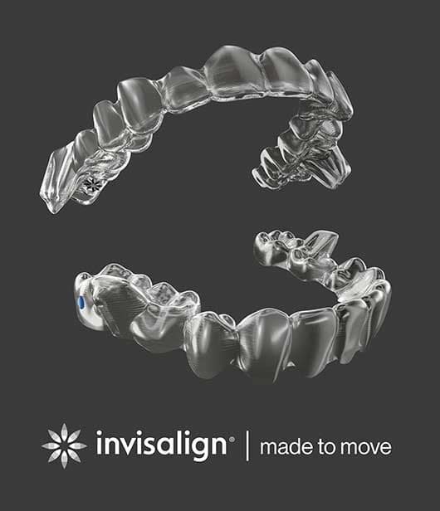
ALIGNERS
IMPORTED--INVISALIGN

Slide 3
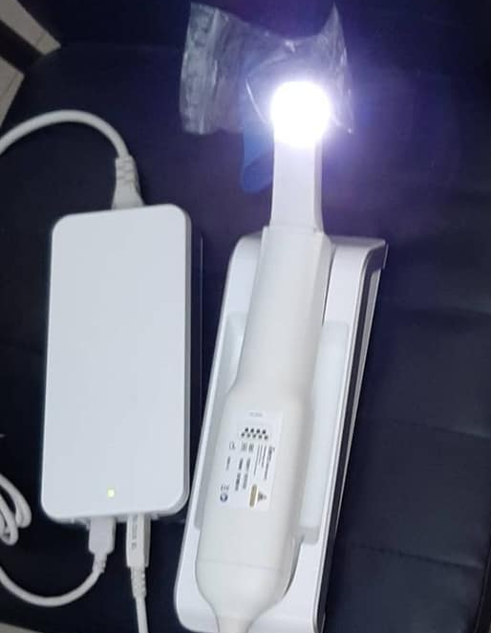
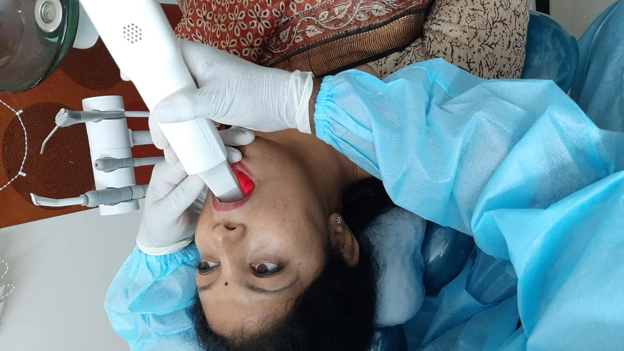
INVISALIGN SCANNING

Slide 4
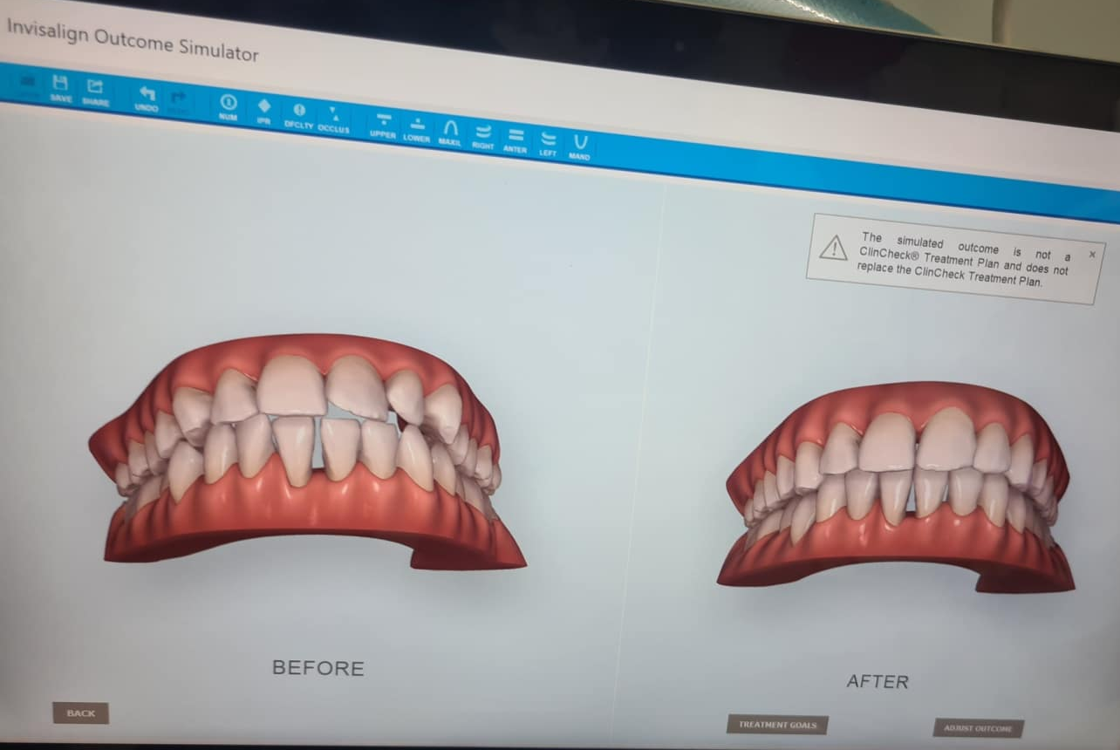
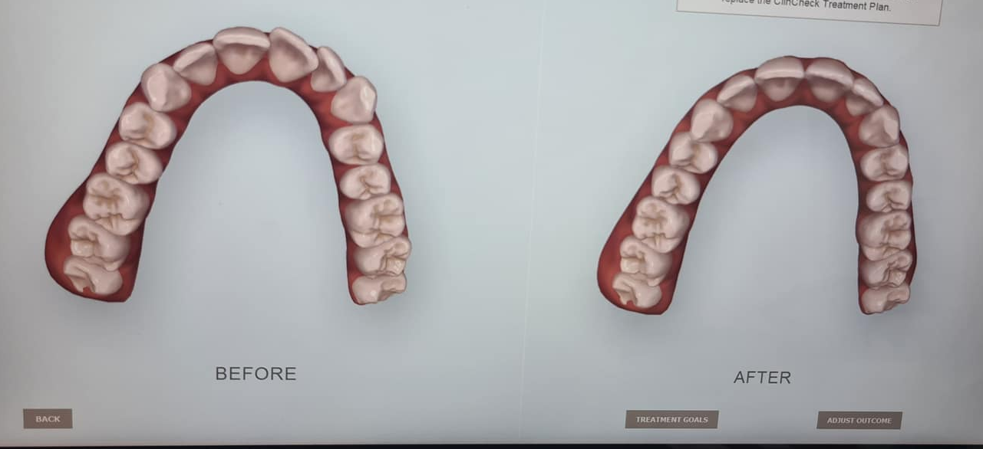
INVISALIGN SIMULATOR

Slide 5
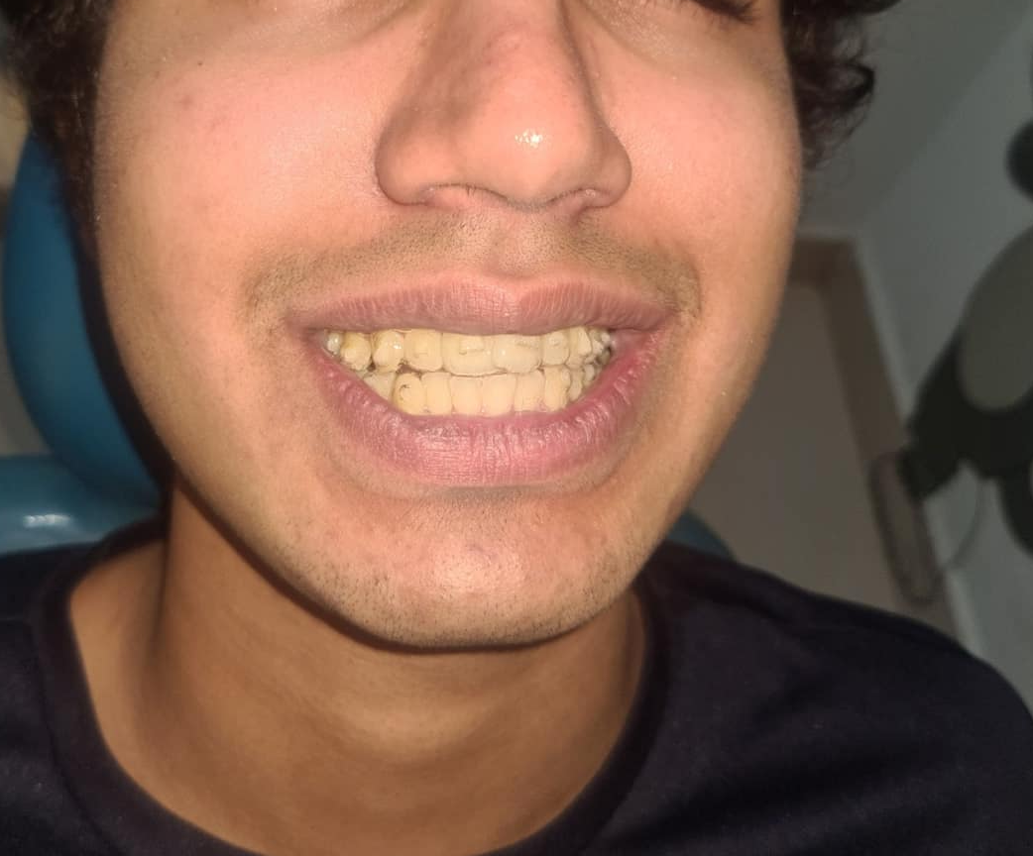
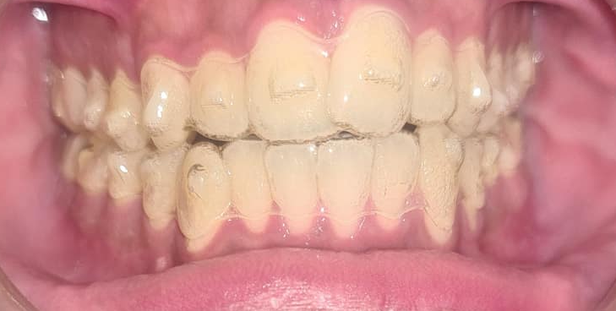

Slide 6
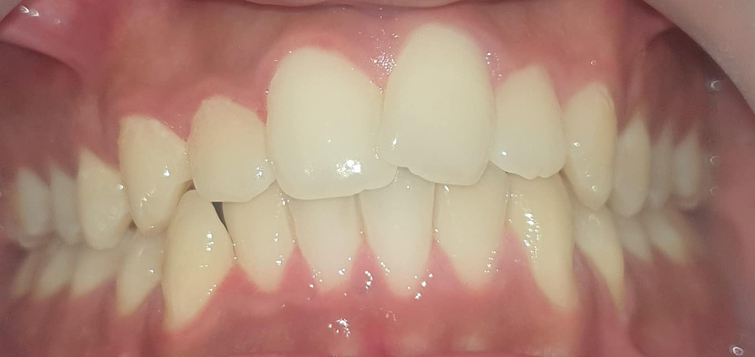
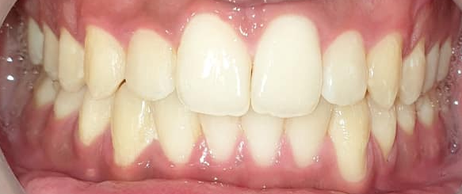

Slide 7
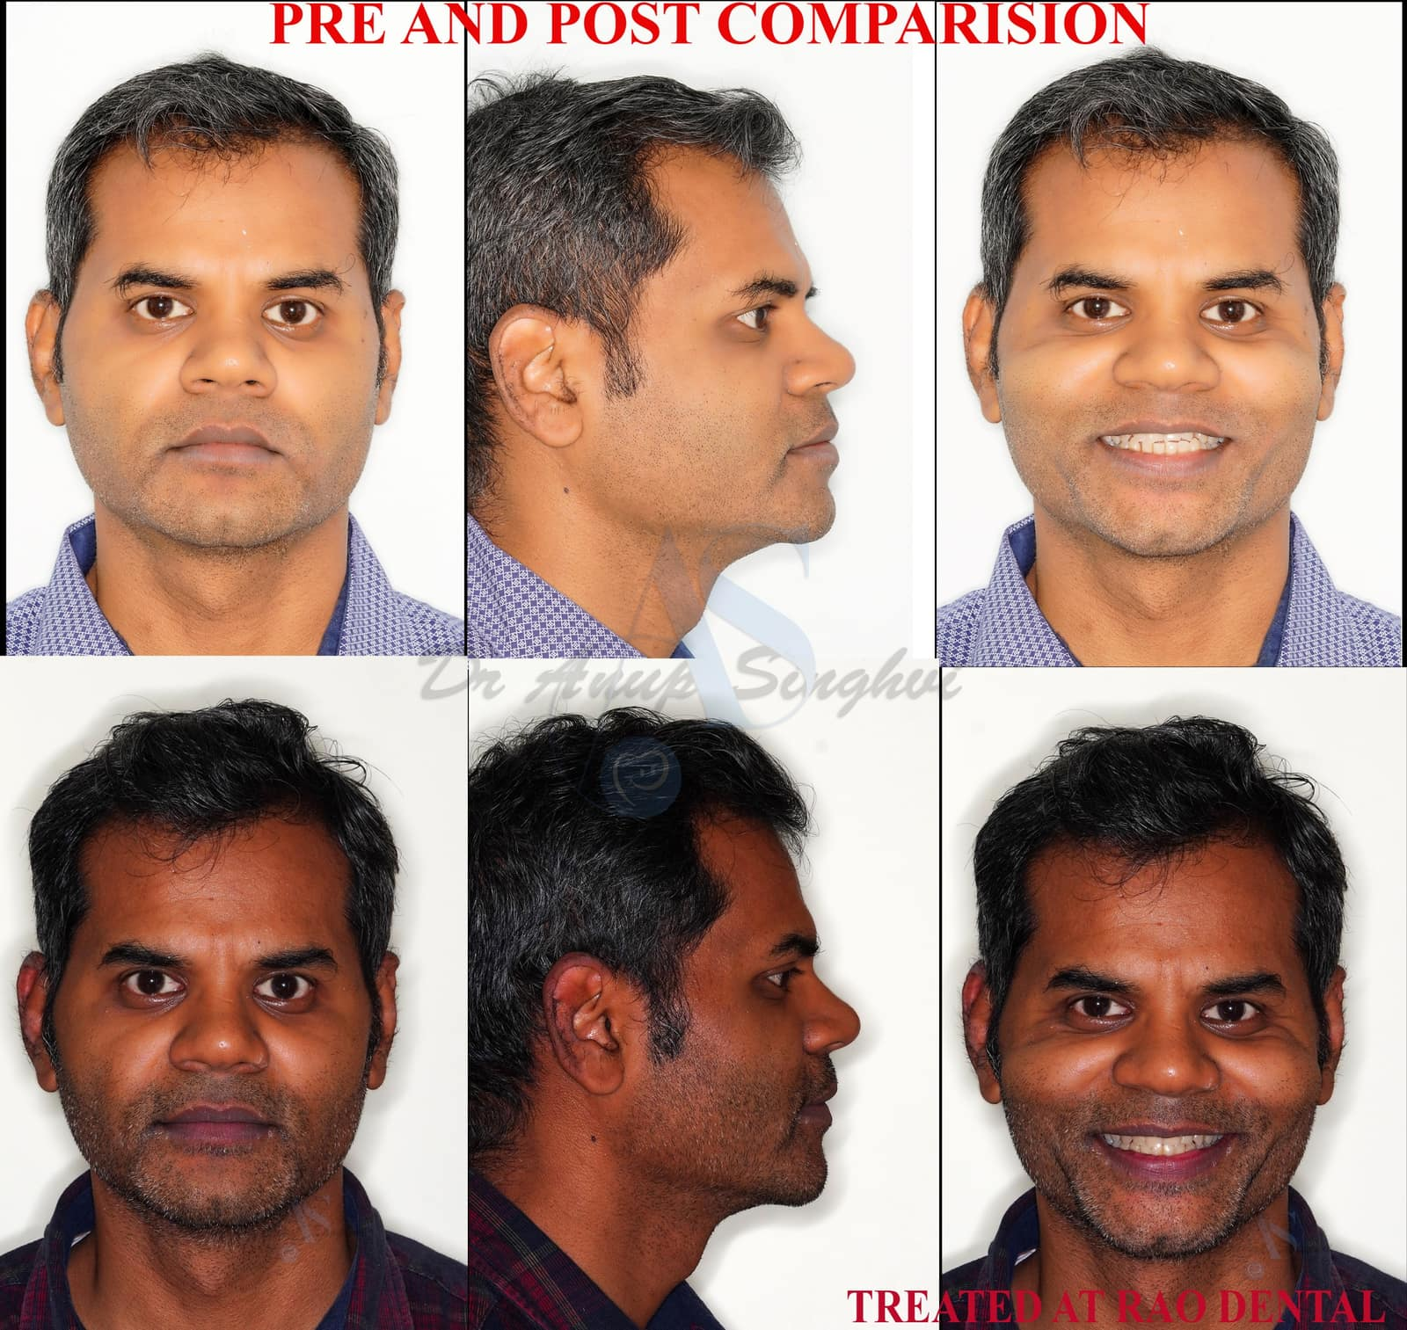
ALIGNERS

Slide 8
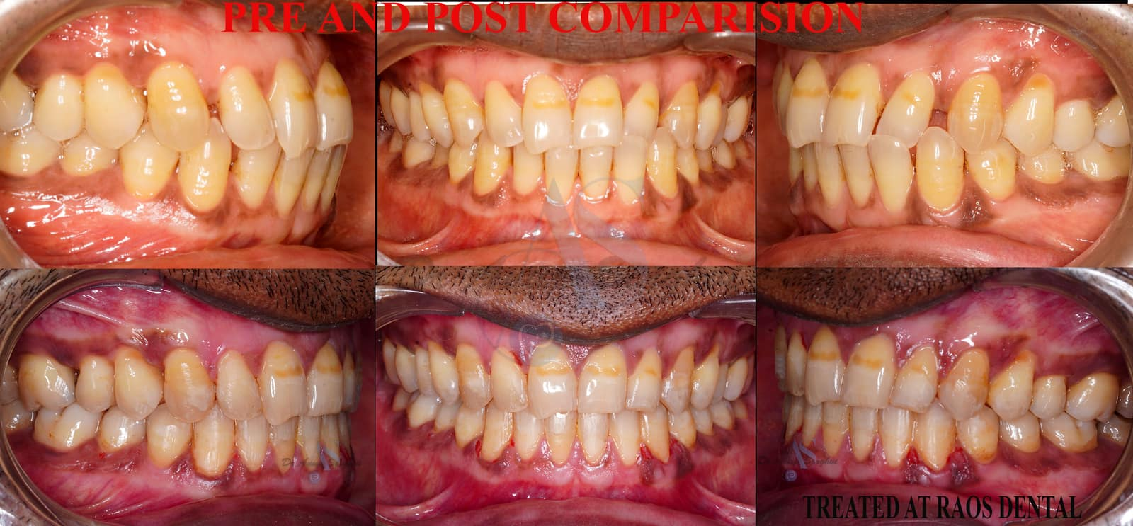
ALIGNERS

Slide 9
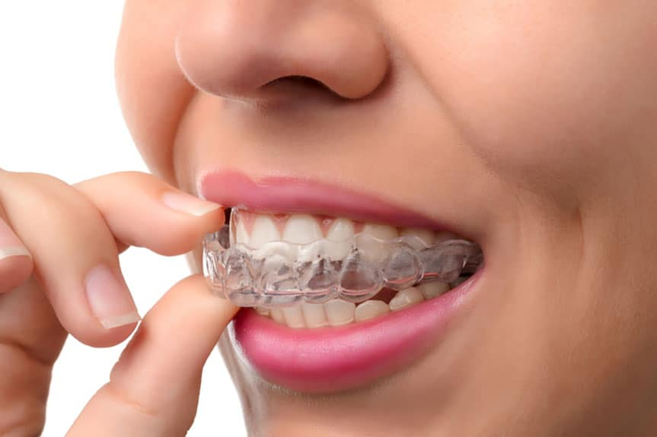

Slide 10
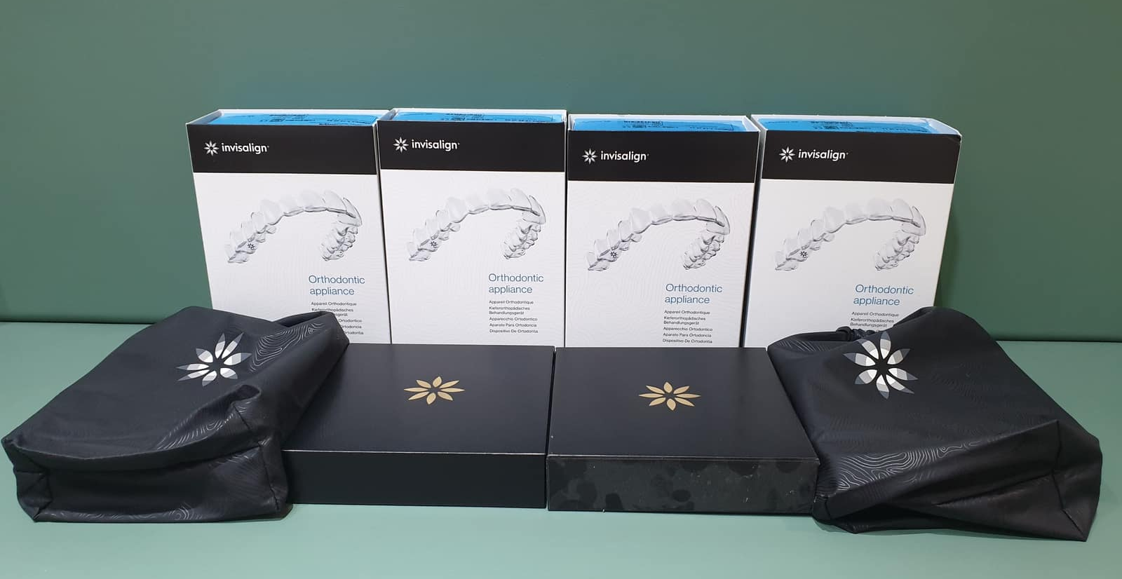
Are you the Next one for
Transformation ?!!?!

Slide 11
braces

Slide 12
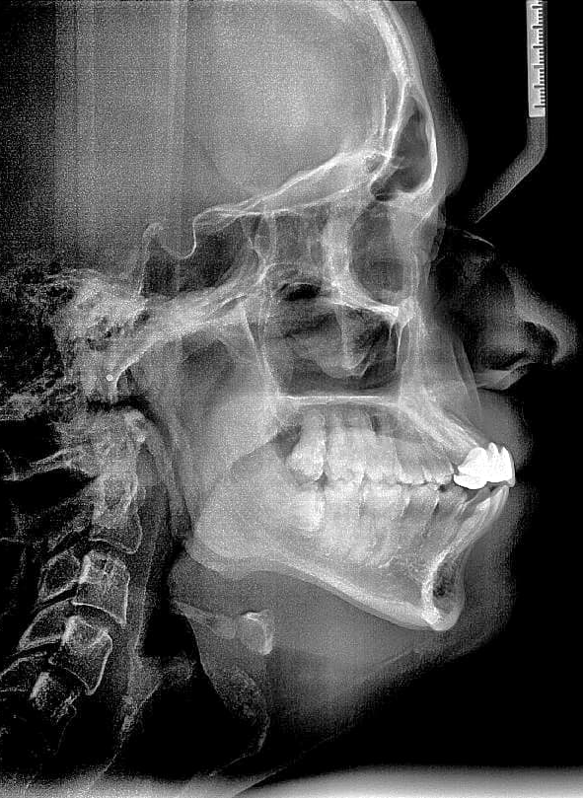
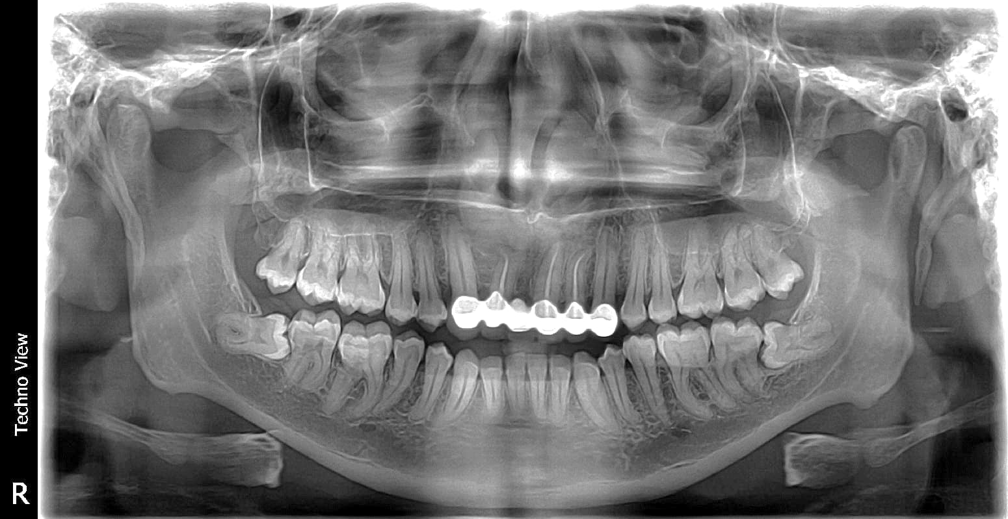
RADIOGRAPHS
PROFILE AND PANORAMIC VIEWS
Dr.Vinayak
Raghunathan
Dr.Vinayak
Raghunathan

Slide 13
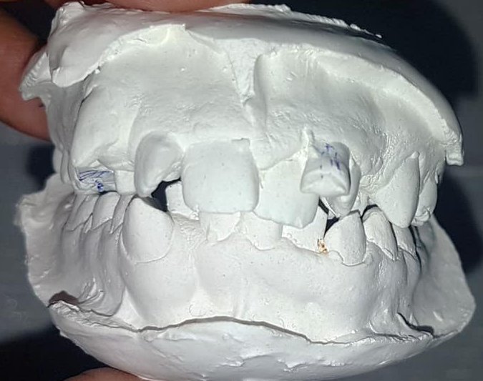
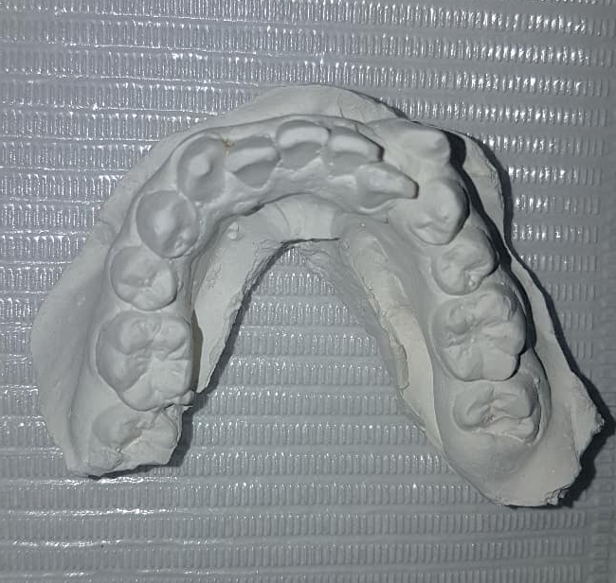
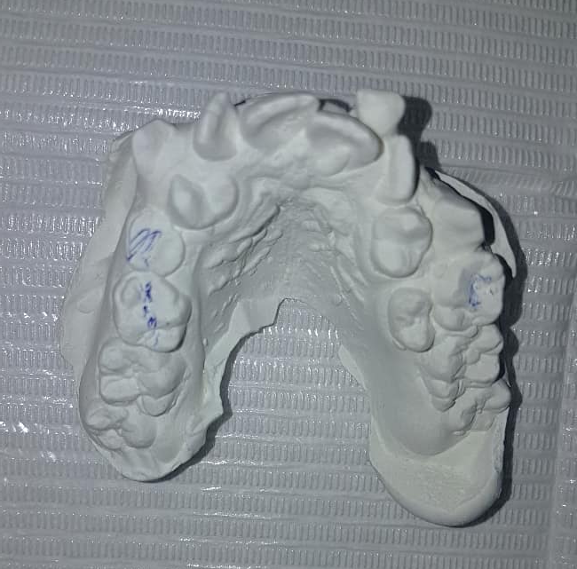
Dr.Vinayak
Raghunathan
MODELS
Dr.Vinayak
Raghunathan
Dr.Vinayak
Raghunathan

Slide 14
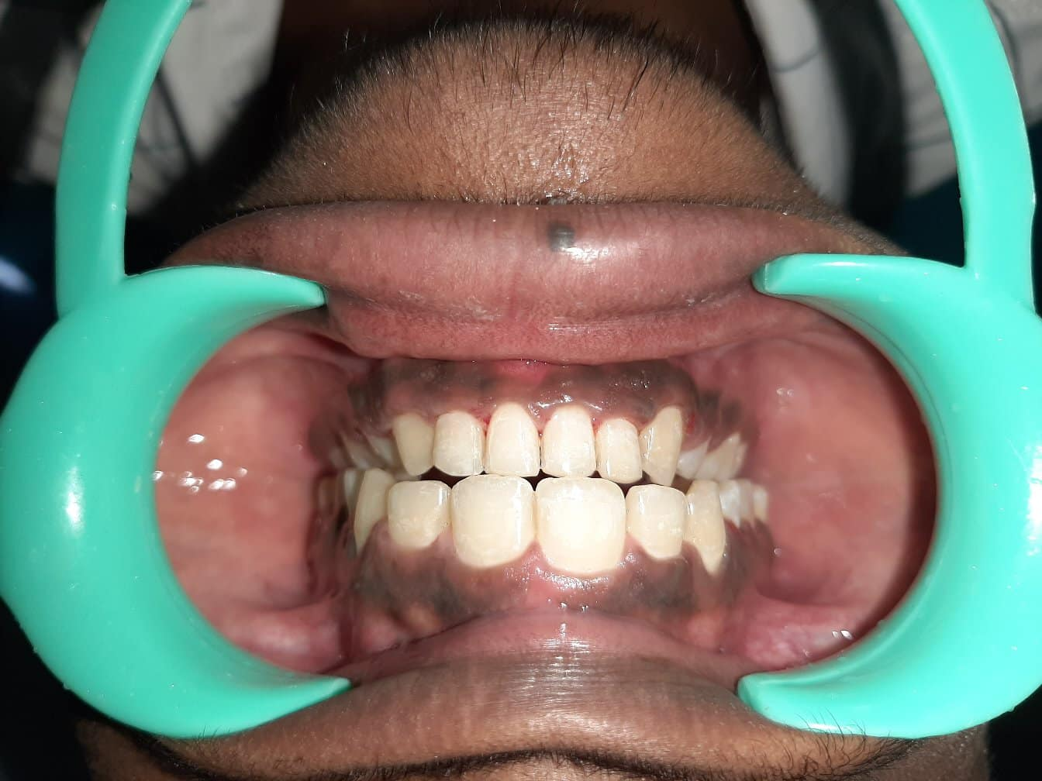
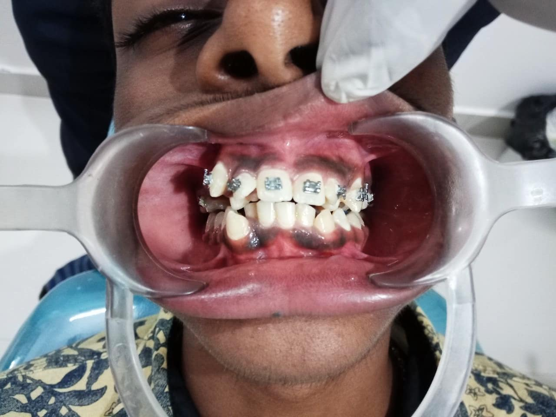
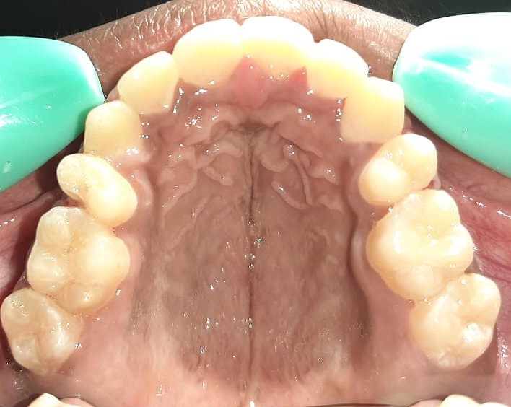
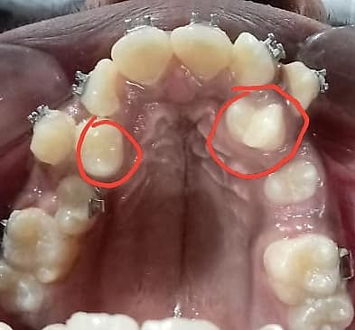

Slide 15
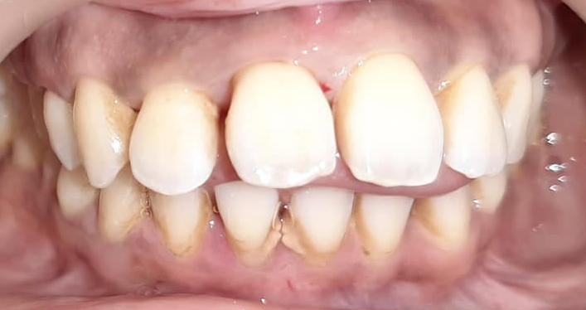
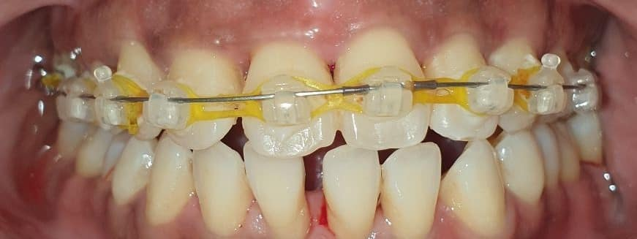
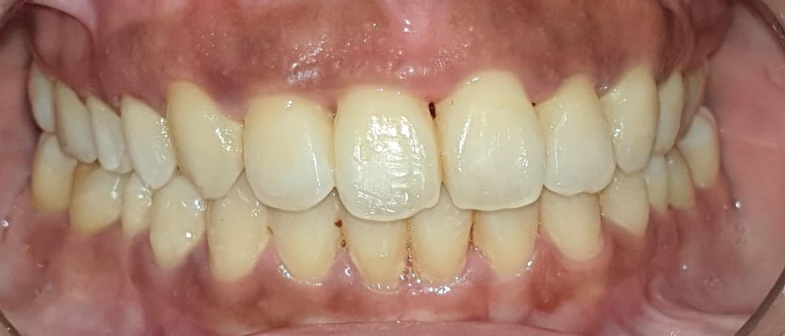

Slide 16
MYO-FUNCTIONAL THERAPY

Slide 17
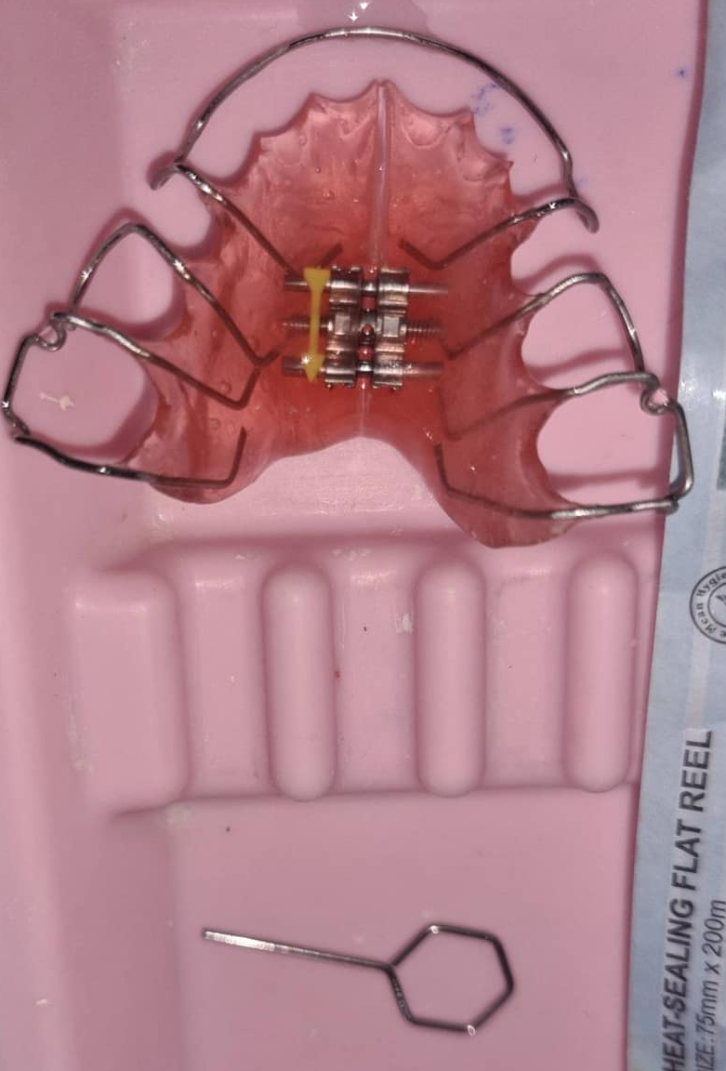
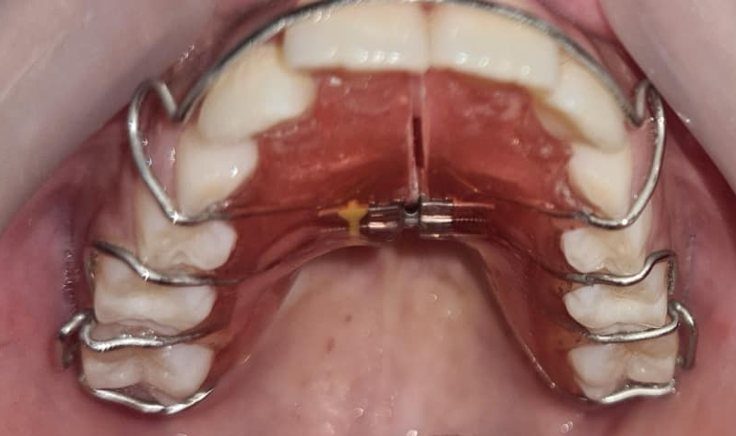
JAW GROWTH
APPLIANCE
TRADITIONAL

Slide 18
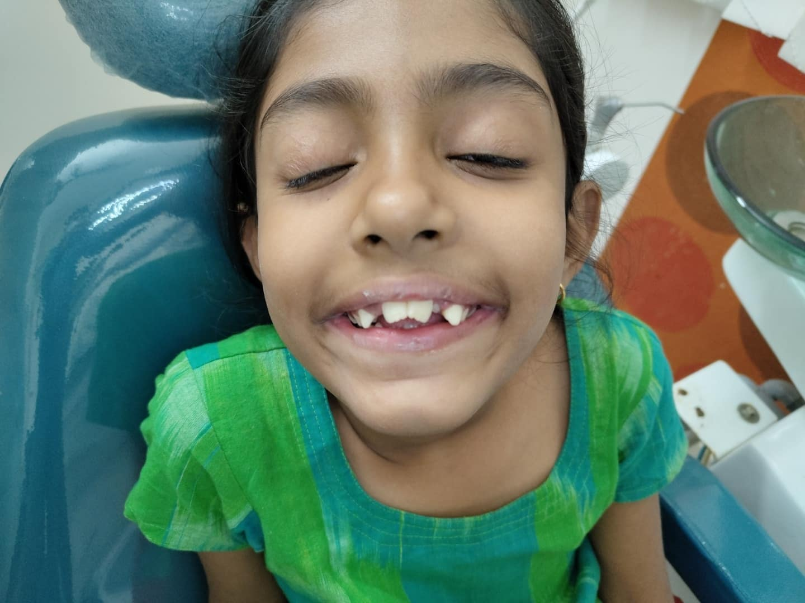
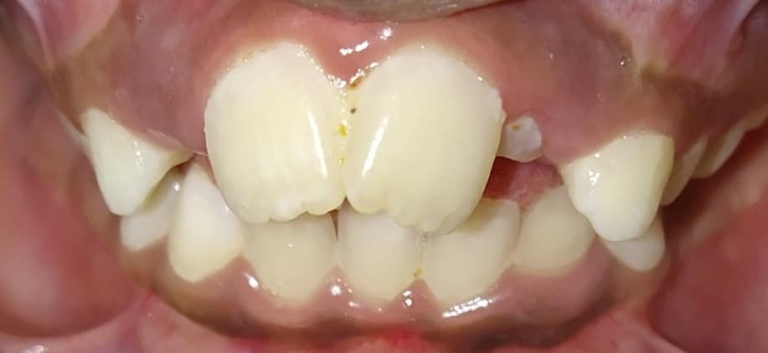
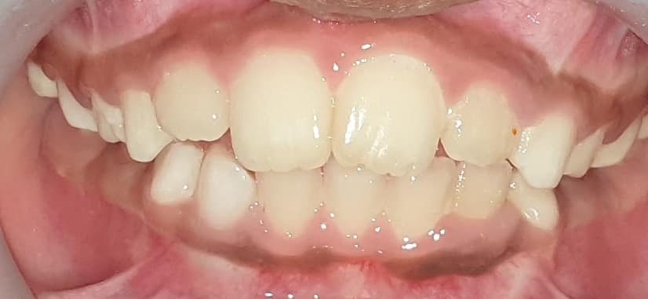
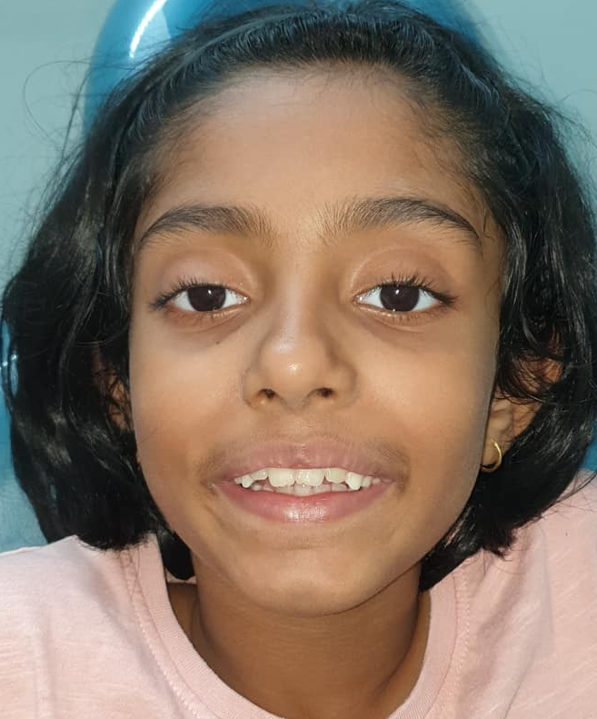
REMOVABLE OR FIXED PALATAL EXPANSION DEVICE
WITH KEY
Rs.18000-Rs.25,000
GROWTH APPLIANCE

Slide 19
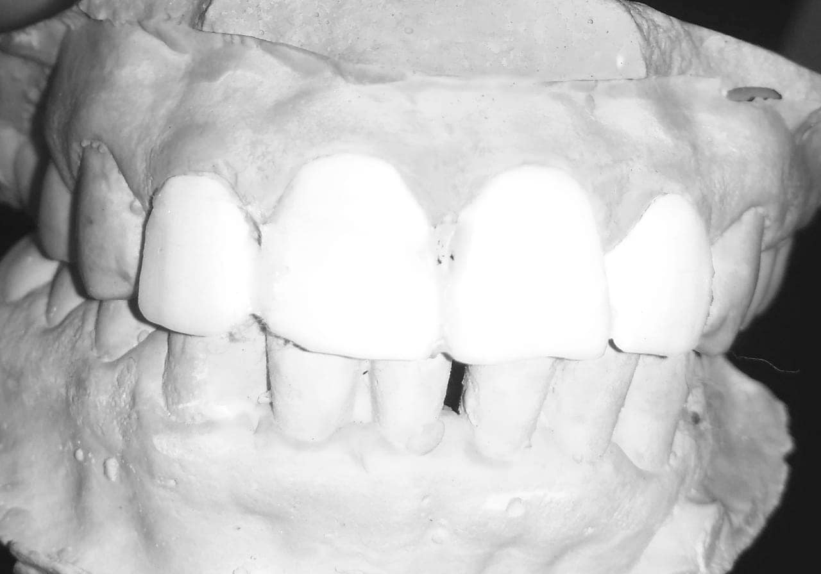
COSMETIC
DENTISTRY
Dr Shraddha Durgan

Slide 20
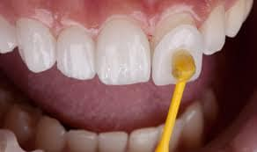
2.LAMINATES

Slide 21
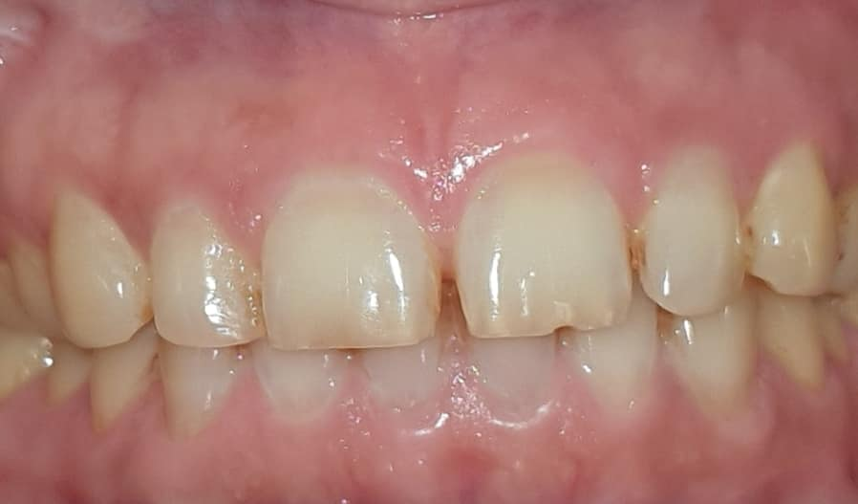
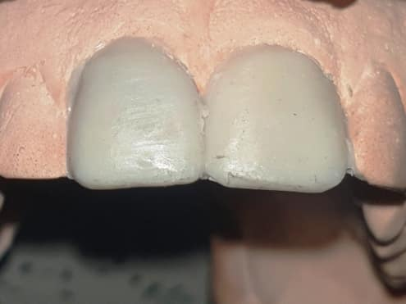
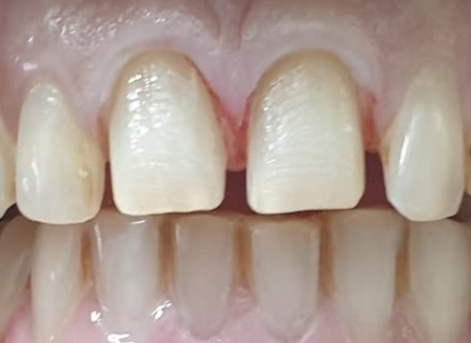
Dr Shraddha Durgan
CASE NO :- 1
Dr Shraddha Durgan

Slide 22
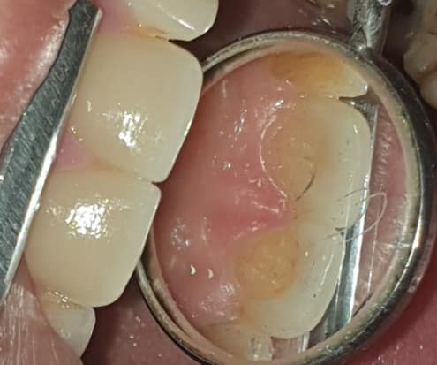
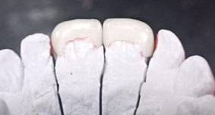
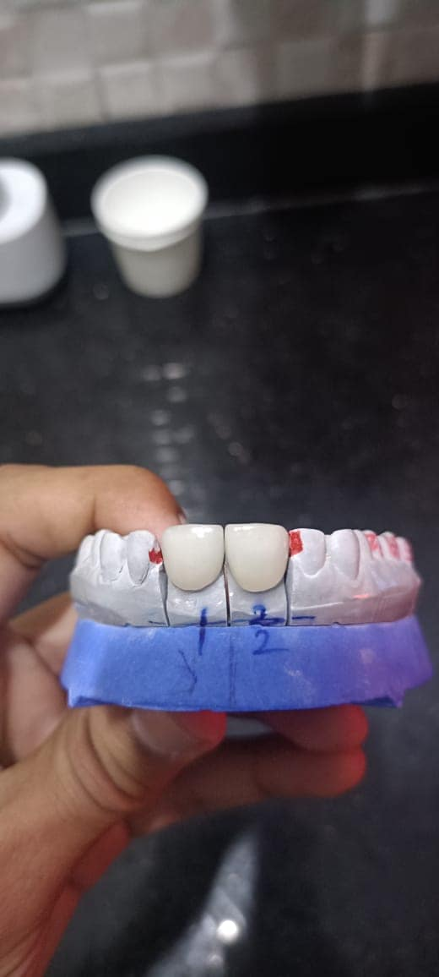
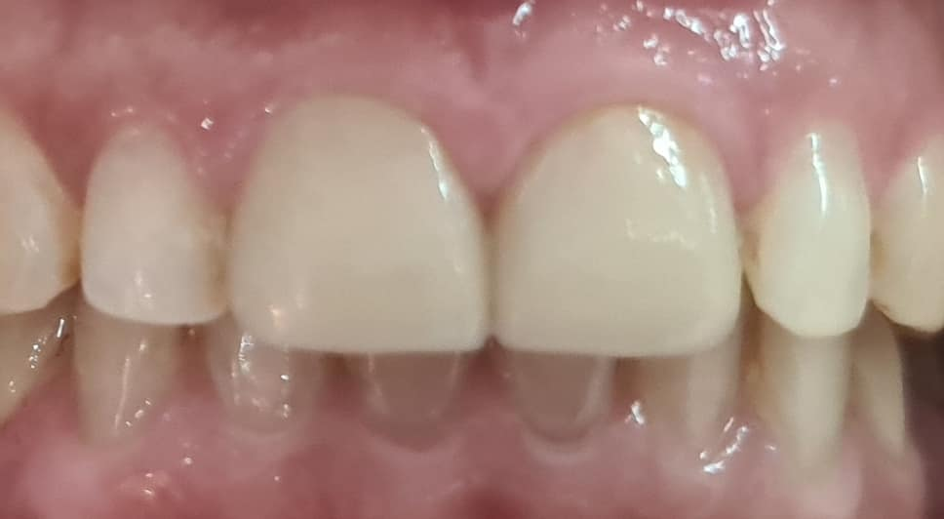

Slide 23
R.c.T and crowns

Slide 24
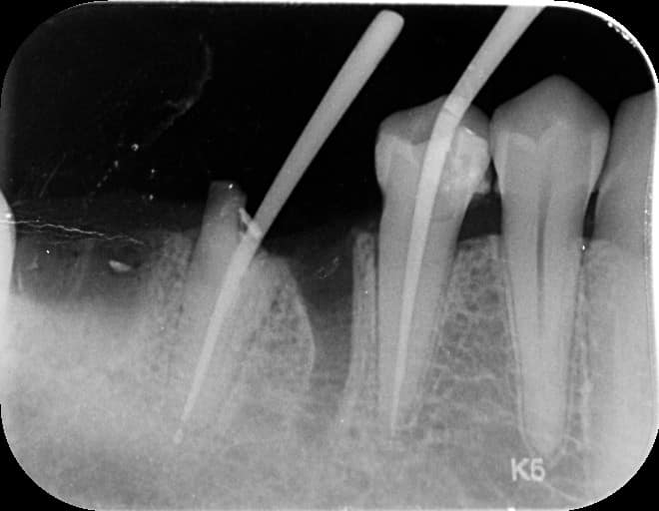
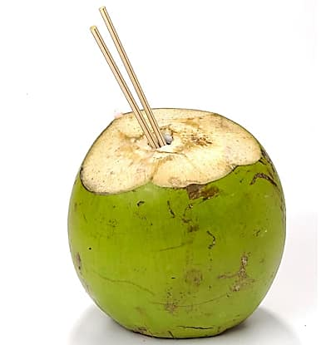
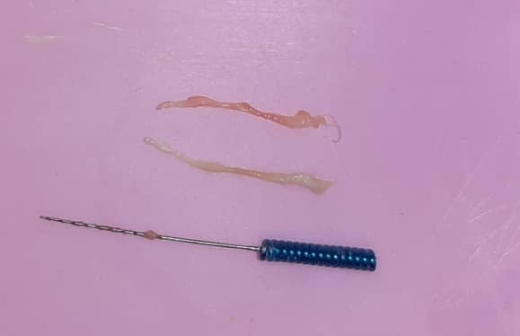
ROOT CANAL THERAPY
( DECAY ON THE PULP TISSUE)

Slide 25
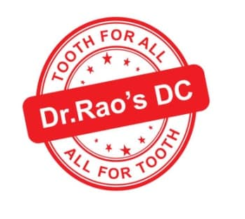
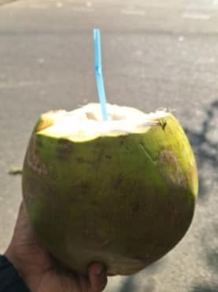

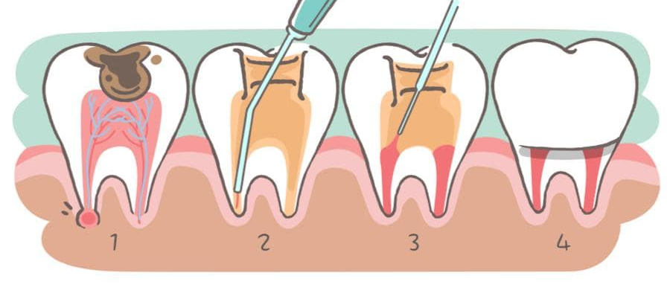
WHAT IS ROOT CANAL TREATMENT
A root canal treatment is a dental procedure to remove inflamed or infected pulp on the inside of the tooth which is then carefully cleaned and disinfected, then filled and sealed. Root canal treatment is designed to eliminate bacteria from the infected root canal and save the natural tooth. Periodic follow-ups has to be done to prevent re-infection of the tooth. [ R.C.T IS A TOOTH-SAVING TREATMENT ]
ACCESS OPENING
2. CLEANING & OBTURATION WITH TEMPORARY FILLING
3. PERMANENT FILLING & CROWN MEASURMENT

Slide 26
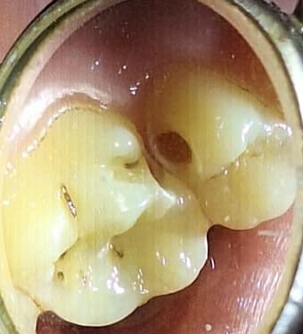
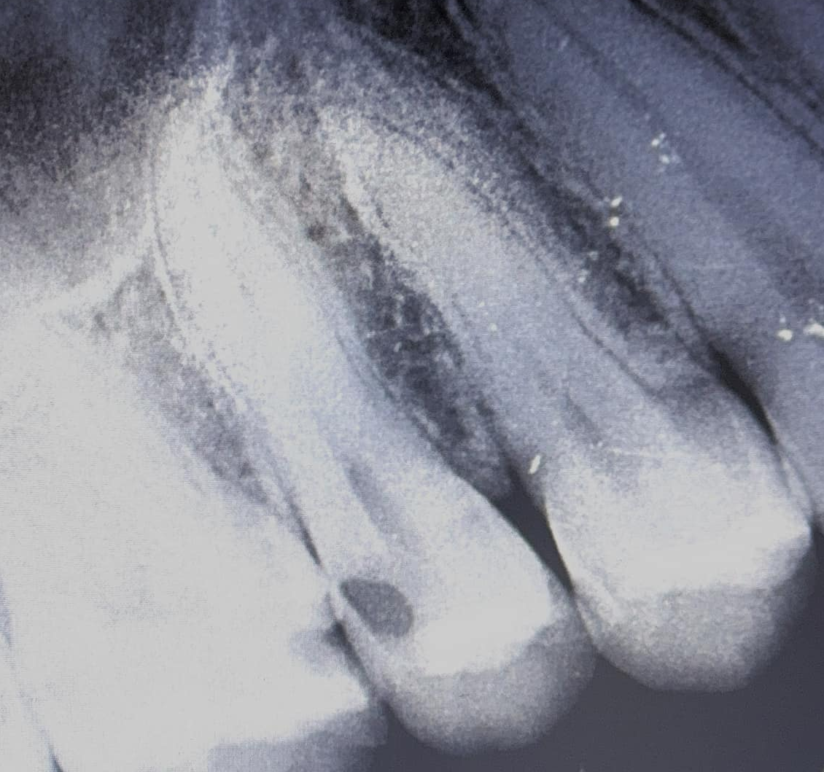
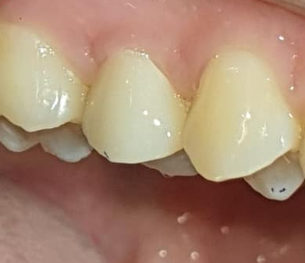

OCCULT CARIES OR HIDDEN CARIES

Slide 27




MANAGEMENT OF PIT CAVITY
PIT
CAVITY

Slide 28




MANAGEMENT OF FOOD LODGEMENT
DUE TO AMALGAM RESTORATIONS
( NON-CALCIFIED CANALS= R.C.T + CROWNS )

Slide 29
Dental implants

Slide 30


?
?
WHY TO
REPLACE
MISSING
TEETH

Slide 31


O.P.G
( FULL
MOUTH
SCAN )

Slide 32






DECAY
SUPRA-ERUPTION
FRACTURE
FRACTURE
SUPRA-ERUPTION
SUPRA-ERUPTION

Slide 33



FRACTURE OF ADJACENT
TOOTH DUE TO BITING FORCE

Slide 34

STEPS IN
DENTAL IMPLANTS
IMPLANT ( 3-6 MONTHS) CONNECTOR CROWN

Slide 35

I.C.C IN DENTAL IMPLANTS
CROWN
CONNECTOR
IMPLANT IN BONE
( 3-6 MONTHS )

Slide 36





CBCT SCAN ( 3D ) FOR BONE WIDTH AND LENGTH
x

Slide 37



7 YEAR FOLLOW-UP
2019
2026

Slide 38


SINGLE TOOTH IMPLANT WITH ZIRCONIA CROWN

Slide 39


RELIEF AT LAST

Slide 40


BEFORE
Dr.Vinayak Raghunathan
TRUST THE JOURNEY
AFTER
Dr.Vinayak Raghunathan

Slide 41




MANAGEMENT OF PROGRESSIVE GAPS

Slide 42



Dr. Vinayak Raghunathan M.D.S
With Director of OSSTEM Company
With Regional Manager of OSSTEM Company

Slide 43
Wisdom tooth

Slide 44
MANAGEMENT OF WISDOM TEETH
1. IMPACTION
2.OPERCULECTOMY
3.R.C.T
Peri-coronal flap removal
b) Bone Trimming

Slide 45






O.P.G/ FULL MOUTH X-RAY
Dr.Vinayak
Raghunathan
Dr.Vinayak Raghunathan

Slide 46




RESULT OF DELAYED TREATMENT
2024
2025

Slide 47

CHEEK BITE PROBLEM

Slide 48
Pediatric dentistry

Slide 49





WHY TO TREAT MILK TeeTH ?
To Avoid SPREAD OF INFECTION TO PERMANENT TEETH
To Avoid PERMANENT DAMAGE TO UNDERLYING PERMANENT TOOTH
IMPROPER TIMING OF PRIMARY TEETH SHEDDING LEADING TO
MAL-ALIGNMENT OF PERMANENT TEETH

Slide 50


RESULT OF WAITING
1.Cyst formation
2.Spread of infection

Slide 51

RESULT OF WAITING

Slide 52





To Avoid SPREAD OF INFECTION TO PERMANENT TEETH
CAVITY IN
MILK TOOTH
Dr Shraddha Durgan
Dr Shraddha
Durgan
Dr Shraddha
Durgan
PULPECTOMY
+
CROWN
Dr Shraddha
Durgan
Dr Shraddha
Durgan
SPACE
MAINTAINER

Slide 53

WITHOUT SPACE MAINTAINER

Slide 54


Dr Shraddha
Durgan
Dr Shraddha
Durgan
2.PERMANENT DAMAGE
TO PERMANENT TOOTH
FROM MILK TOOTH INFECTION
Dr Shraddha
Durgan

Slide 55




3.IMPROPER TIMING OF PRIMARY TOOTH SHEDDING
Dr Shraddha
Durgan
Dr Shraddha
Durgan
Dr Shraddha
Durgan
Dr Shraddha
Durgan

Slide 56




VARIOUS SCENARIOS

